Slide 1
CS3907-80/CS6444-10: Big Data and Analytics
Summer 2021
Stephen H. Kaisler, D.Sc.
Lecture 3 – Introduction to Descriptive and Predictive Analytics
"Statistics can never yield scientific truth"
- French physiologist Claude Bernard –
The purpose of computing is insight, not numbers.
Richard Hamming

Slide 2
Key Skills for Analytics Scientists
A high sense of intellectual curiosity
  The need to know why and how
Mathematically and Logically oriented
  Must be comfortable with mathematics and associated tools
Big Picture Vision:
  Focus on the business decisions while dealing with the data
  Q: What does it all mean?
Detail oriented:
  Able to pay attention to the details no matter how mind-numbing they become
Able to differentiate between tools and methods
  SAS, SPSS, Excel, etc. are “dumb” tools
  Analytics is not SAS; it is using SAS to obtain results using analytical methods
Interpretation skills:
  Numbers by themselves mean nothing
  Expert and domain knowledge are required to interpret the results
CSCI 6444: Big Data & Analytics
Notes:
Being a Data Scientist is being a multimensional individual.
You have to be a problem solver, asking the questions: What Happened?, Why did it Happen? Will it Happen Again? What should we do it prevent it from happening or if it does happen?
Most of data science today is focused on statistical and numerical analysis, but as we shall in a later lecture, my belief it that most analytical techniques need to be non-numerical and incorporate substantial domain knowledge.
You need to see the forest for the trees, but you also need to focus on the trees for important details.
Tools are not methods! Methods use tools to analyze!!
And with substantial domain knowledge, you need to be able to explain and report what you have found.

Slide 3
Training for Analytics Scientists (My View)
4 year college degree in Economics, Mathematics, Physics, Statistics, Ops Research, Decision Sciences, etc.
At least a Masters Degree in one of the above
High proficiency in relational databases (e.g., NoSQL, MySQL) and query languages (e.g., SQL, Pig, Hive)
Knowledge of programming languages: Java, Spark, Python, R, Scala, C/C++ (?)
Experience with domain analytics is a big plus (TBD)
Data modeling
Outstanding Excel and PowerPoint skills
Concise written and verbal communication
Ability to think creatively and abstractly
Highly motivated and results-oriented
CSCI 6444: Big Data & Analytics
3-<number>
Notes:
Having practiced analysis for over 50 years in various forms, I have come to the conclusion you need an in-depth education.
You won’t get all of this in a University or College.
Much of it will be learned through on-the-job training.
Be prepared to apprentice yourself to practicing data scientists to learn the techniques and methods.

Slide 4
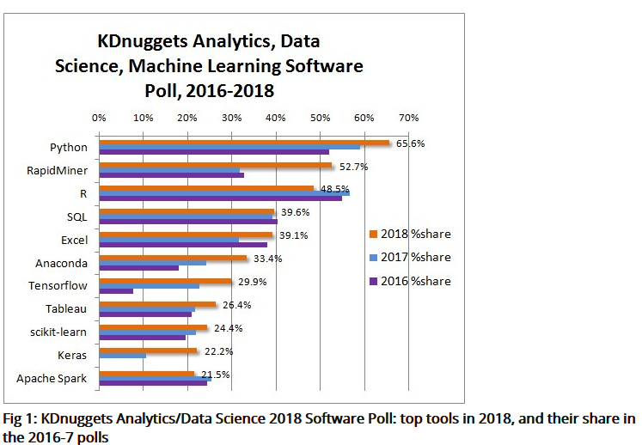
Tools for Data/Analytic Science (2018)
CSCI 6444: Big Data & Analytics
Notes:
The tools that are being used by Data Scientists – a Selection

Slide 5
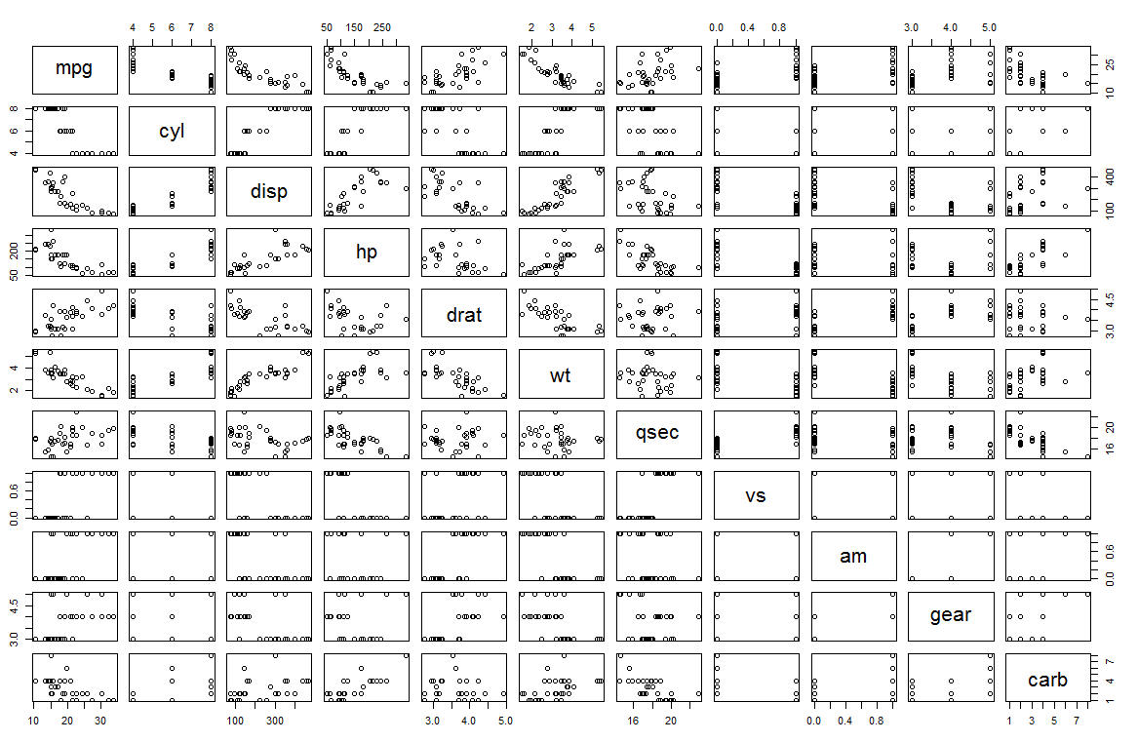
Plotting For Insight - I
CSCI3907-80/CSCI6444-10 Big Data and Analytics
4-<number>
Notes:
Plotting pairwise combinations give some indication of how there may be dependences or not. So, look for clean (near)linear plots, such as mpg vs.disp.
mpg vs disp hints at decreasing exponential function.
Categorical variables with just a few values give you plots such mpg vs gear, which may be helpful, but probably not. Gearing a car is a distinct art.
Drat vs qsec yields no information at all.

Slide 6
Cluster Analysis
Clustering is a broad set of techniques for finding subgroups of observations within a data set.
When we cluster observations, we want observations in the same group to be similar and observations in different groups to be dissimilar.
Because there isn’t a response variable:
  This is an unsupervised method
  Implies that it seeks to find relationships between the n observations without being trained by a response variable.
This problem is NP-Hard!
  But, there a few efficient heuristic algorithms
CSCI3907-80/CSCI6444-10 Big Data and Analytics
4-<number>
Notes:
Clustering is a widely used technique in data analytics to understand the data the we have.
We try to cluster observations into subsets that are described by similar characteristics. That is, the members of subset A are more similar to each other than they are to members of subset B.
Remember N1 and N2 in last week’s slide on Anomalies?
……..
The class P of problems are those that can be solve with a polynomial-time algorithm.
Conversely, NP problems are those which require non-deterministic polynomial time.
If we could an algorithm in P that solves a problem in NP, then we could find P-type algorithms for every problem in NP.
But, P /= NP, so it is suspected no such algorithm exists.
You may revisit this in the Design of Algorithms Course.

Slide 7
Cluster Analysis
General Common Steps:
  Choose Appropriate Attributes
  Scale the Data
  Screen for Outliers
  Calculate Distances
  Select a Clustering Algorithm – you will use K-Means and one other
  Obtain One or More Cluster Solutions
  Determine # Clusters Present
  Obtain Final Clustering Solution
  Visualize The Results
  Interpret the Clusters
  Validate The Clusters
You should follow these steps in Project #2
See “Revised Notes on Kmeans vs kNN”
CSCI3907-80/CSCI6444-10 Big Data and Analytics
4-<number>
Notes:
So, we will explore clustering as an analytic technique applicable to large data sets.
You also will be doing predictive analytics.

Slide 8
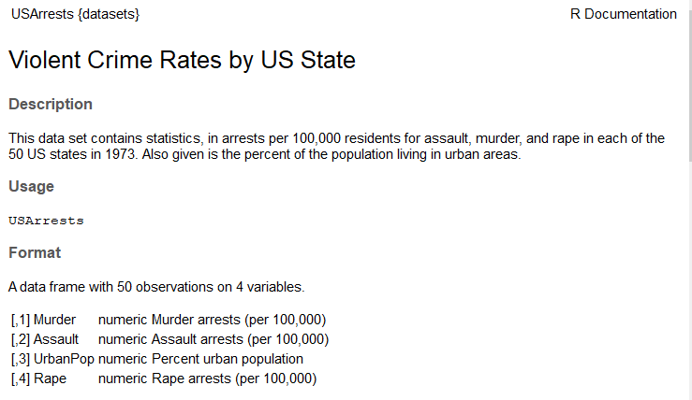
Data Set: USArrests
Type “USArrests” in help in RStudio
CSCI3907-80/CSCI6444-10 Big Data and Analytics
4-<number>
Notes:
USArrests is a built-in data set.
So, questions to ask:
What is the correlation between Urban Population and the crime rate? E.g., do more crimes of a specific type occur in areas with a larger urban population?
What is the correlation between Murder and the other two crimes? E.g., how many assaults might lead to murder, similarly, for rapes.
Rank states by population, then by crimes.
Note: We do not have explicit data on whether a specific assault or rape led to murder. So, we can’t go much further with this analysis.
We need to make sure – when we do data science – that we have enough explanatory data to be able to perform the analysis.
How do we know this? By having domain knowledge.
That is, we know the general outlines of the problem, but not the specifics. That’s where data and data science help us to understand the problem in detail so can explain it and, perhaps, devise solutions.

Slide 9
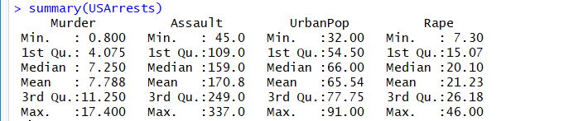
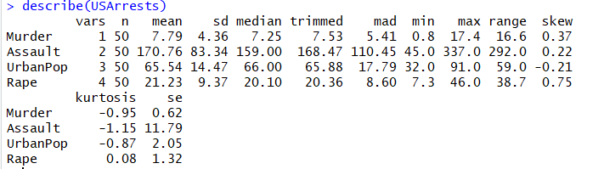
Describing USArrests
Type ‘summary’ in RStudio help pane
Type ‘describe’ in RStudio help pane
CSCI3907-80/CSCI6444-10 Big Data and Analytics
4-<number>
Notes:
We’ll review a few of the methods that you can use to start to understand the data set.
A quartile is a type of quantile which divides the number of data points into four more or less equal parts, or quarters. The first quartile (Q₁) is defined as the middle number between the smallest number and the median of the data set.
The second quartile (Q₂) is the median of a data set and 50% of the data lies below this point. The third quartile (Q₃) is the middle value between the median and the highest value of the data set.
skewness is a measure of the asymmetry of the probability distribution of a real-valued random variable about its mean. The skewness value can be positive, zero, negative, or undefined. positive skew indicates that the tail is on the right.
Kurtosis is a measure of whether the data are heavy-tailed or light-tailed relative to a normal distribution. That is, data sets with high kurtosis tend to have heavy tails, or outliers. Data sets with low kurtosis tend to have light tails, or lack of outliers.

Slide 10
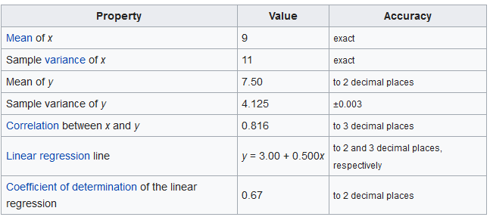
Anscombe’s Quartet - I
Anscombe's quartet comprises four datasets that have nearly identical simple descriptive statistics, yet appear very different when graphed. Each dataset consists of eleven (x,y) points. They were constructed in 1973 by the statistician Francis Anscombe to demonstrate both the importance of graphing data before analyzing it and the effect of outliers on statistical properties. He described the article as being intended to counter the impression among statisticians that "numerical calculations are exact, but graphs are rough. (Wikipedia)
Axiom: Beware of statistics!
CSCI3907-80/CSCI6444-10 Big Data and Analytics
4-<number>
Notes:
Summary statistics allow us to describe a dataset using just a few key numbers. But, they should be only one of your tools.
BTW: If you haven’t read Mark Twain’s note on statistics, go back and read it.
Some examples of Problems:
a. This data set has a mean of 15 and a standard deviation of 0: (15,15,15).
b. Suppose you are given the following data:
1st quartile = 7
Median = 8
3rd quartile = 9
Mean = 8.5
Standard deviation = 2
Range = 5
Can you compute the five number summary for this data set?
No, because you don’t have the minimum and maximum values.

Slide 11
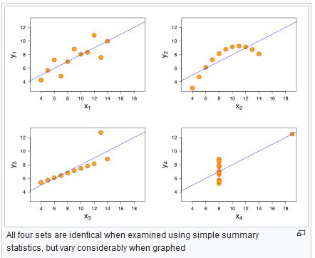
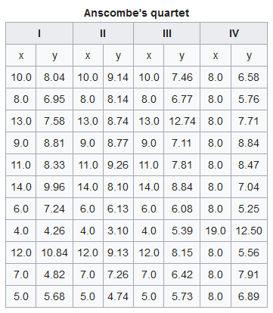
Anscombe’s Quartet - II
CSCI3907-80/CSCI6444-10 Big Data and Analytics
4-<number>
Notes:
Dataset I consists of a set of points that appear to follow a rough linear relationship with some variance.
Dataset II fits a neat curve but doesn’t follow a linear relationship (maybe it’s quadratic?).
Dataset III looks like a tight linear relationship between x and y, except for one large outlier.
Dataset IV looks like x remains constant, except for one outlier as well.
Computing summary statistics or staring at the data wouldn’t have told us any of these stories. Instead, it’s important to visualize the data to get a clear picture of what’s going on.
Axiom: Plotting is your friend!!
See “Same Stats-DifferentGraphs.pdf” in Technical Papers

Slide 12
Anscombe’s Quartet - III
The first scatter plot (top left) appears to be a simple linear relationship, corresponding to two variables correlated and following the assumption of normality.
The second graph (top right) is not distributed normally; while a relationship between the two variables is obvious, it is not linear, and the Pearson correlation coefficient is not relevant. A more general regression and the corresponding coefficient of determination would be more appropriate.
In the third graph (bottom left), the distribution is linear, but should have a different regression line (a robust regression would have been called for). The calculated regression is offset by the one outlier which exerts enough influence to lower the correlation coefficient from 1 to 0.816.
Finally, the fourth graph (bottom right) shows an example when one outlier is enough to produce a high correlation coefficient, even though the other data points do not indicate any relationship between the variables.
The quartet is still often used to illustrate the importance of looking at a set of data graphically before starting to analyze it according to a particular type of relationship, and the inadequacy of basic statistic properties for describing realistic datasets
CSCI3907-80/CSCI6444-10 Big Data and Analytics
4-<number>
Notes:
The four datasets that were intentionally created to describe the importance of data visualization and how any regression algorithms can be fooled by the same.
Hence, all the important features in the dataset must be visualized before implementing any statistical or machine learning algorithm on them which will help to make a good fit model.
Axiom: Know Your Domain!!
Axiom: Know Your Data!!
Axiom: Always graph your data before you analyze!!

Slide 13
Preparing the Data
Arrange your data in a matrix.
Rows are observations and columns are variables.
Any missing value in the data must be removed or estimated.
  Why? Because it can cause errors in analysis
  Estimation can occur in several ways
  May also want to handle outliers
The data must be standardized (i.e., scaled or normalized) to make variables comparable.
  Why? Some values that are too large compared to others will skew the analysis and the results.
  Standardization consists of transforming the variables such that they have mean of zero and standard deviation of one.
CSCI3907-80/CSCI6444-10 Big Data and Analytics
4-<number>
Notes:
An outlier is an observation that appears out of place in a sample.
There may be several reasons why outliers are present.
-It may be an error in the data.
-It may be an unlikely but random variation.
-Or it may be an indication that some model assumptions are incorrect.
In the previous graphs, we were able to see the outliers by plotting the data.
There are several tests for outliers. Look at R contributed packages to find one. Some you might consider:
Box Plot, uses quartiles
Scatter Plot, a plot on a 2d/3d coordinate set
InterQuartile Range (IQR), a measure of statistical dispersion
Standard Deviation (SD)
Isolation Forest (IF), works well with high dimension datasets
Asi Pointed out last week, you will learn a lot more through OJT and practice.

Slide 14
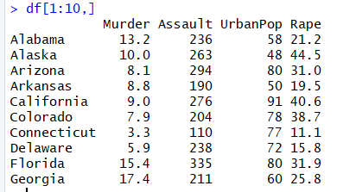
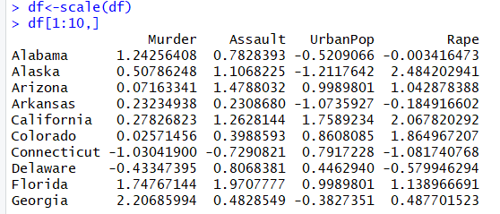
Removing Missing Data
Copy data to a working variable
>df <- USArrests
>df <- na.omit(df)
Note: we print only the first 10 rows, but all columns.
CSCI3907-80/CSCI6444-10 Big Data and Analytics
4-<number>
Notes:
In R, missing values are represented by the symbol NA (not available). Impossible values (e.g., dividing by zero) are represented by the symbol NaN (not a number).
Use the R function:
is.na(x) # returns TRUE if x is missing data values
For the project data set, you can either eliminate that row or replace the missing value by the mean of all the values for that variable.
But, you have to be careful, as substituting the mean for a missing value (or several missing values) can skew the data set statistics and analysis result.
If you have a very large number of observations, it might be better to just eliminate the few missing observations, but don’t throw them away – put them off to the side.

Slide 15
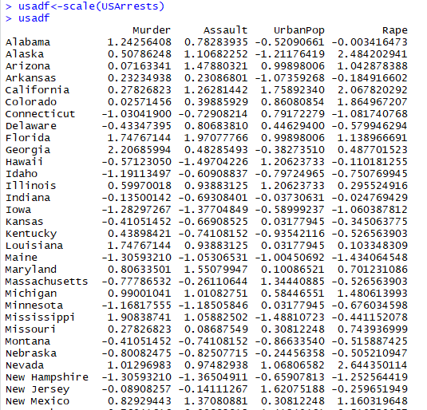

Scaling the Data
CSCI3907-80/CSCI6444-10 Big Data and Analytics
4-<number>
Notes:
Scale, with default settings, will calculate the mean and standard deviation of the entire vector, then "scale" each element by those values by subtracting the mean and dividing by the standard deviation.
If you use scale(x, scale=FALSE), it will only subtract the mean but not divide by the standard deviation.
When using scale, you are not changing the data, rather you are changing the scale (the axis values when plotting). Think of grabbing the axis at the two ends and stretching or compressing it.
See “R in Action” for an example of scale.

Slide 16
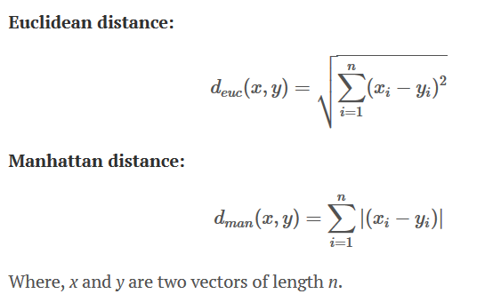
Measuring Distance
Clustering requires measuring distances between pairs of observations.
  The result is a dissimilarity or distance matrix.
The classical methods for distance measures are Euclidean and Manhattan distances:
CSCI3907-80/CSCI6444-10 Big Data and Analytics
4-<number>
Notes:
Euclidean distance is a very simple linear metric between two points in a d-dimensional space.
The Manhattan distance is also know as the taxicab distance the distance between two points is the sum of the absolute differences of their Cartesian coordinates.
Often used in Chess in computing values of
moves of pieces on the chess board.

Slide 17
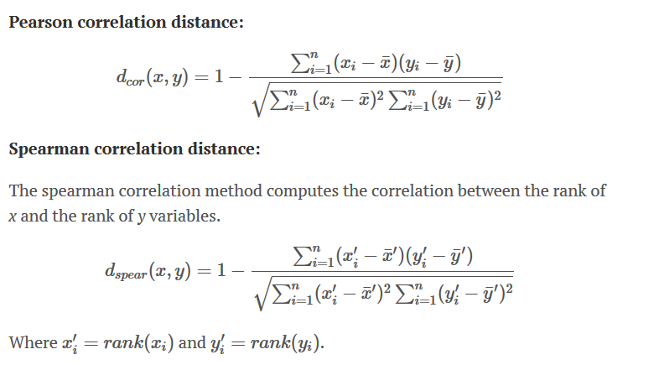
Other Correlation Measures of Distance
Look up the definition of these two correlation measures in a good statistics book or on Wikipedia.
CSCI3907-80/CSCI6444-10 Big Data and Analytics
4-<number>
Notes:
Pearson correlation distance can be used to measure the similarity in shape between two profiles or clusters.
Correlation-based distance considers two objects to be similar if their features are highly correlated, even though the observed values may be far apart in terms of Euclidean distance. The distance between two objects is zero when they are perfectly correlated. Pearson's correlation is quite sensitive to outliers.
But, can cause problems with Kmeans clustering due to grouping anti-correlated objects that perturb the centroid.
Spearman correlation distance looks at the rank of the values in a data set (sorted by ascending or descending order) or some other assigned ranking. The rank is the position in the data set based on an ordering criterion.

Slide 18
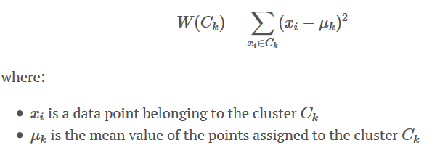
K-Means Clustering - I
K-means clustering is the most commonly used unsupervised “machine learning” algorithm for partitioning a given data set into a set of k groups (i.e. k clusters), where k represents the number of groups pre-specified by the analyst.
In k-means clustering, each cluster is represented by its center (i.e, centroid) which corresponds to the mean of points assigned to the cluster.
There are several k-means algorithms available.
The standard algorithm is the Hartigan-Wong algorithm (1979), which defines the total within-cluster variation as the sum of squared distances Euclidean distances between items and the corresponding centroid:
CSCI3907-80/CSCI6444-10 Big Data and Analytics
4-<number>
Notes:
The task of identifying subgroups in the data such that data points in the same subgroup (cluster) are very similar while data points in different clusters are very different.
In other words, we try to find homogeneous subgroups within the data such that data points in each cluster are as similar as possible according to a similarity measure.
Clustering is considered an unsupervised learning method since we don’t have the ground truth to compare the output of the clustering algorithm to the true labels to evaluate its performance.
Thus, it automatically “discovers” natural grouping in data, e.g., it only interprets the input data and find natural groups or clusters in the feature space.

Slide 19

K-Means Clustering - II
Each observation (x_{i}) is assigned to a given cluster such that the sum of squares (SS) distance of the observation to their assigned cluster centers (μ_{k}) is minimized.
We define the total within-cluster variation as follows:
The total within-cluster sum of square measures the compactness (i.e., goodness) of the clustering and we want it to be as small as possible.
C_{k} is a cluster
CSCI3907-80/CSCI6444-10 Big Data and Analytics
4-<number>
Notes:
Since clustering algorithms including kmeans use distance-based measurements to determine the similarity between data points, it’s recommended to standardize the data to have a mean of zero and a standard deviation of one since almost always the features in any dataset would have different units of measurements such as age vs income.
Given kmeans iterative nature and the random initialization of centroids at the start of the algorithm, different initializations may lead to different clusters since kmeans algorithm may stuck in a local optimum and may not converge to global optimum. Therefore, it’s recommended to run the algorithm using different initializations of centroids and pick the results of the run that that yielded the lower sum of squared distance.
Why use Kmeans?
Get a meaningful intuition of the structure of the data we’re dealing with.
Cluster-then-predict where different models will be built for different subgroups if we believe there is a wide variation in the behaviors of different subgroups. An example of that is clustering patients into different subgroups and build a model for each subgroup to predict the probability of the risk of having heart attack.
It is simple to understand what is going on.

Slide 20

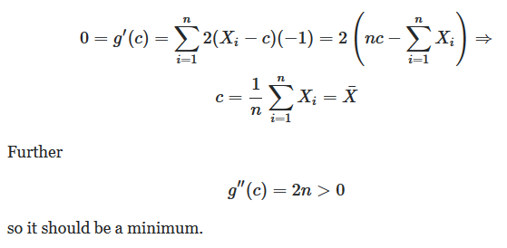
K-Means Clustering - IIa
The sum of squares of a sample of data is minimized when the sample mean is used as the basis of the calculation.
Sum-of-squares measures the dispersion of data points.
  Minimizing SS leads to compactness of the clusters
We have g(c) > = 0. So, for relative extrema c:
g(c) is differentiable. The minimum must occur where dg(c)/dc = 0.
CSCI3907-80/CSCI6444-10 Big Data and Analytics
4-<number>
Notes:
When a cluster is compact, the members of the cluster are very similar to each other.
If we have a large sum-of-squares, that means the points are similar, but there may be significant differentiability.
Choosing the appropriate threshold for the “radius” of the cluster has a strong effect on who is in and who is out.
Often, after clustering, you need to examine the individual members to see where they differed and where they did not.
You might want to compute clustering membership on only a few key attributes as opposed to all attributes of an object.

Slide 21
K-Means Clustering - III
Basic Algorithm:
  Select K centroids
    Pick rows at random from your vector
    # rows depends on # clusters to start with
  Assign each data point to its closest centroid using a distance metric (following slides)
  Recalculate the centroids as the average of all data points in a cluster
    Centroids are p-length means vectors ( p = #attributes)
  Assign data points to the closest centroid
  Continue steps 3 and 4 until no re-assignments, or some maximum number of iterations reached
    R uses 10 as the default # iterations
CSCI3907-80/CSCI6444-10 Big Data and Analytics
4-<number>
Notes:
Kmeans is an iterative algorithm.
You often need to experiment with the number of iterations, especially if the size of the data set is very large.
And, experiment with the number of clusters you choose. Given N objects, 1 and N are NOT good choices for the number of clusters.
Note: variants on Kmeans use the mode and the median instead of the average in picking the next centroid.
Measuring cluster quality:
Inertia: Intuitively, inertia tells how far away the points within a cluster are. Therefore, a small value for inertia is aimed for. The range of inertia’s value starts from zero and goes up.
Silhouette score: Silhouette score tells how far away the data points in one cluster are, from the data points in another cluster. The range of silhouette score is from -1 to 1. Score should be closer to 1 than -1.

Slide 22
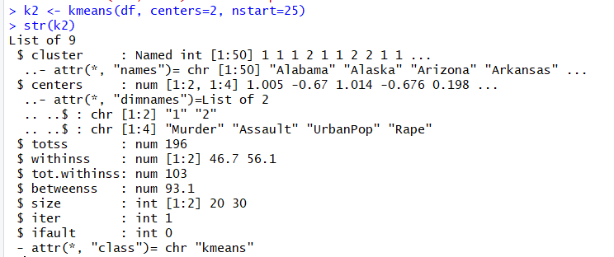
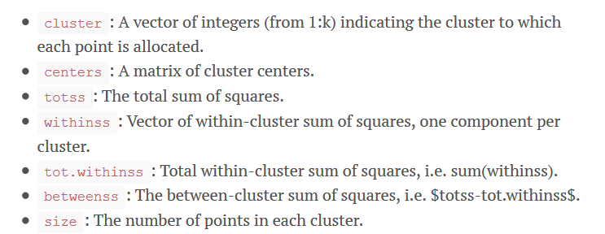
K-Means Clustering-IV
Note: These fields contain data generated by kmeans.
CSCI3907-80/CSCI6444-10 Big Data and Analytics
4-<number>
Notes:
Kmeans has several arguments that you can try out:
kmeans(x, centers, iter.max = 10, nstart = 1, algorithm = c("Hartigan-Wong", "Lloyd", "Forgy", "MacQueen"), trace=FALSE)
Arguments
X: numeric matrix of data, or an object that can be coerced to such a matrix (such as a numeric vector or a data frame with all numeric columns).
Centers: either the number of clusters, say k, or a set of initial (distinct) cluster centres. If a number, a random set of (distinct) rows in x is chosen as the initial centres.
iter.max: the maximum number of iterations allowed.
Nstart: if centers is a number, how many random sets should be chosen?
algorithm character: may be abbreviated. Note that "Lloyd" and "Forgy" are alternative names for one algorithm.
Object: an R object of class "kmeans", typically the result of object <- kmeans(..).
method character: may be abbreviated. "centers" causes fitted to return cluster centers (one for each input point) and "classes" causes fitted to return a vector of class assignments.
Trace: logical or integer number, currently only used in the default method ("Hartigan-Wong"): if positive (or true), tracing information on the progress of the algorithm is produced. Higher values may produce more tracing information.

Slide 23
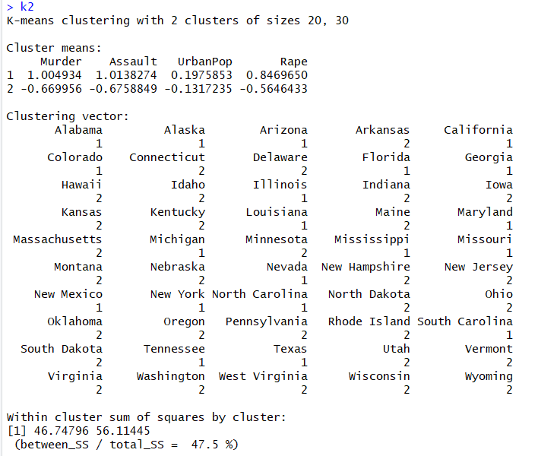
Kmeans Clustering-V
CSCI3907-80/CSCI6444-10 Big Data and Analytics
4-<number>
Notes:
Start with two clusters:
We get clusters of 20 and 30 states each.
Kmeans provides the membership of each cluster. Unless you know a lot about the demographics of each state, this probably doesn’t help much.
We really need more data to do a good job of analysis.
Note: This is meant to show you how to use the methods, not to suggest we can extract more than a little meaning from the data.
We need a much richer data set and we need detailed understanding of the demographics, geographics, and socal data to really examine this problem.

Slide 24
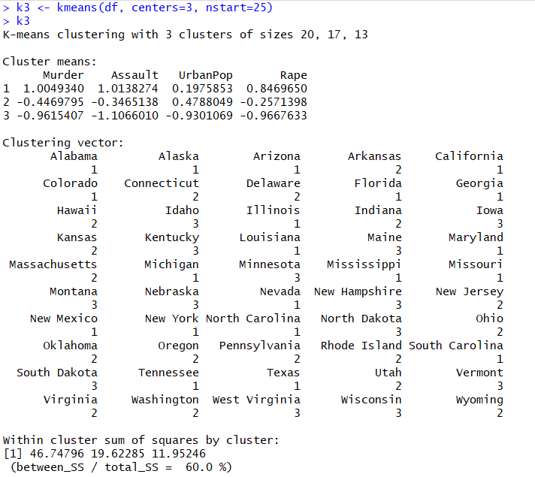
Kmeans Clustering-VI
nstart specifies how many different random starting assignments R will use; it picks the best results.
Note difference here from
centers = 2.
You should try 4 and 5 to see if this ratio improves.
CSCI3907-80/CSCI6444-10 Big Data and Analytics
4-<number>
Notes:
Lets try 3 clusters:
We get clusters of 20, 17, and 13.
Does cluster 1 have the same members as in k2?
If we examine clusters 2 and 3 and use our knowledge of demographics, we may be able to understand some of the reasons for differentiation in the two clusters.

Slide 25
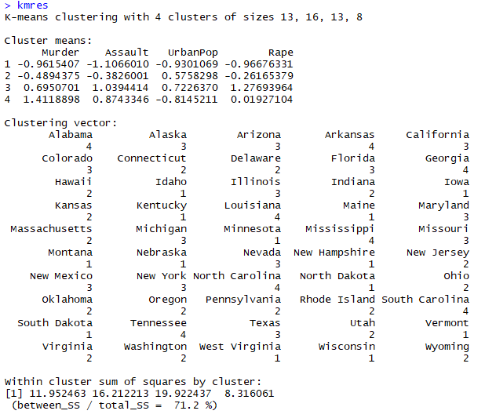
Kmeans Clustering-VII
Kmeans w/ = 4, nstart = 25
CSCI3907-80/CSCI6444-10 Big Data and Analytics
4-<number>
Notes:
So, betweenss/totalss = 71.2%
This tell us we are finding good clusters.
Note cluster 1 has been subdivided. Where did its members go – to one other cluster or redistributed?
And why?
At each stage of analysis, some new questions may arise that suggest further analyses to be done.
A key issue and one that is hard to solve is: When should we stop the analysis?
Some might say: When you have solved the problem?
BUT, do you know when this is? Domain knowledge can help when analysis routines may not.
Again, statistics does not offer insight, only grist for interpretation of the data.
Grist: Something that can be used to your advantage.

Slide 26

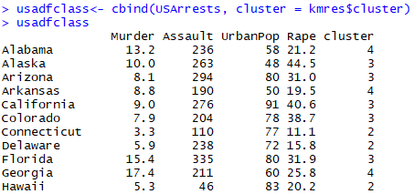
Kmeans Clustering - VIII
Compute the means by cluster using the original data
Add the point classifications to the original data
CSCI3907-80/CSCI6444-10 Big Data and Analytics
4-<number>
Notes:
Here we can enrich our data seta little by adding the cluster number to the data once we are satisfied with the clustering results.

Slide 27
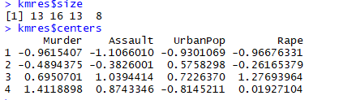
Kmeans Clustering
Get the size and the centers
Get a cluster plot:
CSCI3907-80/CSCI6444-10 Big Data and Analytics
4-<number>
Notes:
See the next page for the plot.

Slide 28
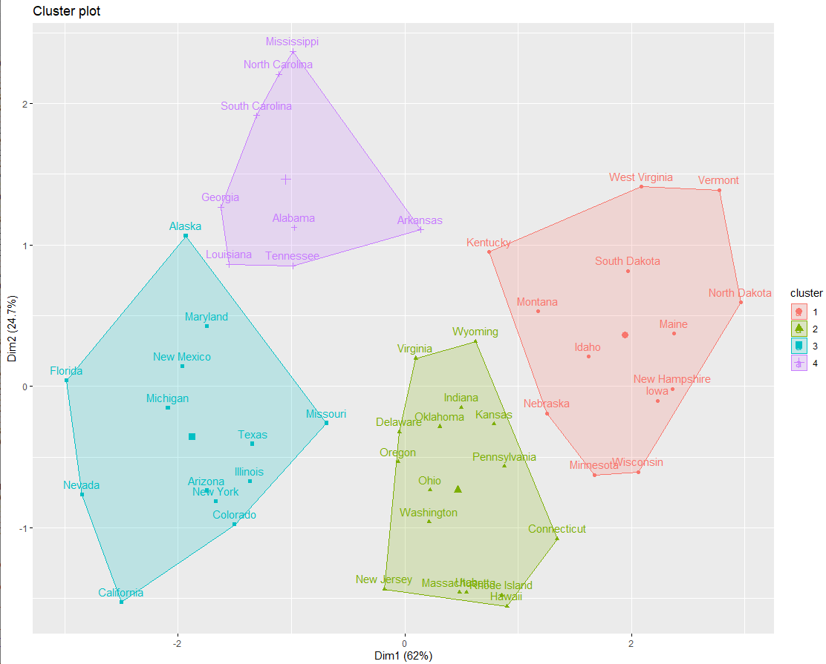
Kmeans Clustering – X
CSCI3907-80/CSCI6444-10 Big Data and Analytics
4-<number>
Notes:
You can use ggplot2 in lieu of the built-in plot routine to “prettify” your plots.
Notice that these clusters have good separation.
Some further things to think about:
Look at the shape, e.g., the convexity of the clusters.
Using our domain knowledge, we can ask what is similar and what is different about the states in each cluster.
We can compare the attributes of states on the convex hull, the perimeter surrounding the cluster.
We should ask what attributes push those states to the convex hull.

Slide 29
Kmeans Clustering-VII
In kmeans, the algorithm stops when:
  Maximum number of iterations reached
  The change to “within cluster sum-of-squares” in two successive iterations is less than the threshold value
The within-cluster sum of squares is a measure of the variability of the observations within each cluster.
  In general, a cluster that has a small sum of squares is more compact than a cluster that has a large sum of squares.
  Clusters that have higher values exhibit greater variability of the observations within the cluster.
  But, as the number of observations increases, the sum of squares becomes larger.
The ratio (between_ss/total_ss) is a measure of the variance in the data set.
k-means minimizes the within group dispersion and maximizes the between-group dispersion.
By assigning the samples to k clusters rather than n (number of samples) clusters, k-means achieved a reduction in sums of squares of 88.4 %
CSCI3907-80/CSCI6444-10 Big Data and Analytics
4-<number>

Slide 30
Finding A Good Number of Clusters
Plotting the total within-groups sums of squares against the number of clusters in a K-means solution can be helpful.
A bend in the graph can suggest the appropriate number of clusters.
Use this function:
wssplot <- function(data, nc=15, seed=1234)
{
wss <- (nrow(data)-1)*sum(apply(data,2,var))
for (i in 2:nc)
{
set.seed(seed)
wss[i] <- sum(kmeans(data, centers=i)$withinss)
}
plot(1:nc, wss, type="b",
xlab="Number of Clusters",
ylab="Within groups sum of squares")
}
The data parameter is the numeric dataset to be analyzed, nc is the maximum number
of clusters to consider, and seed is a random number seed.
CSCI3907-80/CSCI6444-10 Big Data and Analytics
4-<number>
Notes:
Kmeans is a converging algorithm.
Eventually, it will converge to a set of clusters, but –depending on the size of the data set – it may take a long time.
It may appear for awhile that over several iterations, that objects are moving between clusters without convergence.
Note that the duration of each iteration depends on the number of comparisons per cluster. Given a cluster of N objects, N-1 comparisons need to be made with the centroid at each iteration.
So, duration for iteration m = Σ Σ (Ci-Xij), j = 1,|Ci|, j /=I; i = #clusters
Where Ci is Cluster i’s centroid at each iteration, Xj represent the objects in the cluster

Slide 31
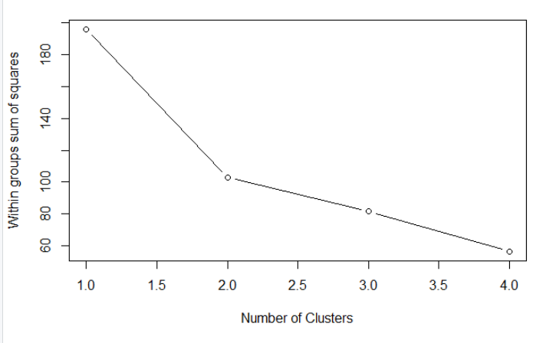
Finding a Good Number of Clusters
wssplot(df,nc=4,seed=1234)
CSCI3907-80/CSCI6444-10 Big Data and Analytics
4-<number>
Notes:
The value of inertia is measured on the Y-axis.
The value of inertia decreases as the number of clusters increase.
Rule of thumb: The elbow point in the inertia graph is a good choice because after that the change in the value of inertia isn’t significant.

Slide 32
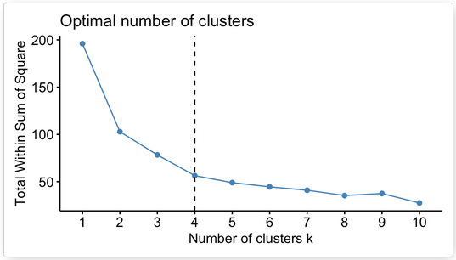
factoextra
Plotting clusters: Use the factoextra package to create graphs of clusters
Use the fviz_nbclust() method in factoextra to get an estimate of the optimal number of clusters.
  But, you should still experiment with different numbers of clusters.
Where the bend occurs, e.g., the slope decreases is an indicator of the best number of clusters.
CSCI3907-80/CSCI6444-10 Big Data and Analytics
4-<number>
Notes:
Another approach to estimating the number of clusters required.
Estimating the number of clusters can be difficult.
For example, if you have surveyed your data set or have a good understanding of the variance in data in it, then you can use a smaller number of clusters for you initial estimate because you can assume that most objects will be in a few clusters.
It is always useful to start with some estimate that is small and work your way up. Using plot to show the clusters often helps you to visualize how well the data is clustering.
The built-in kmeans algorithm does not let you set the threshold. So, if you do not see good separation developing, you should consider finding a version of kmeans that allows you to select the threshold.

Slide 33
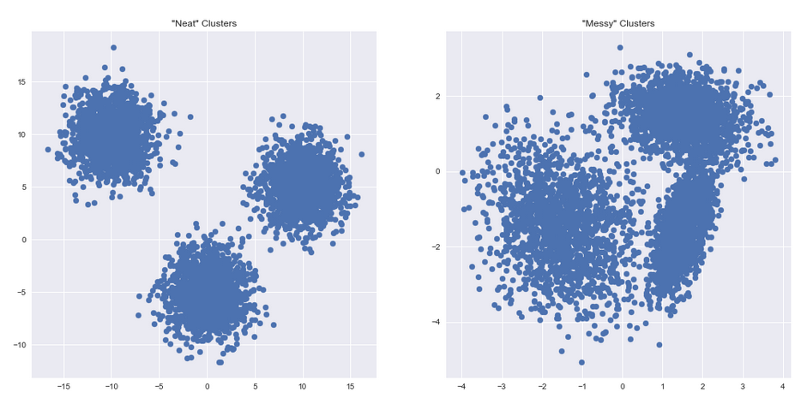
K-Means: Issues
Very sensitive to the initial selection of centroids:
  Do many runs of kmeans, each with different initial centroids.
  Seed the centroids using a better method than random. (e.g. Farthest-first sampling)
Must manually choose k
  Pick an initial k: Suggested is sqrt(n) where n is # points
  But, for very large n, leads to very large k, which is/maybe absurd!
Real-life data is almost always messy.
  Lots of noise obscuring the signal, large dispersion.
CSCI3907-80/CSCI6444-10 Big Data and Analytics
4-<number>
Notes:
Look at these two figures.
Good separation between the clusters in the left hand figure.
Pick a good threshold, good centroid, and good distance algorithm.
This is an empirical process!!
Now, look at the right hand figure. The right most clusters do not have good separation. Lots of objects in between the left cluster and the other two. An indication the thresholds are too large so that the clusters overlap.

Slide 34
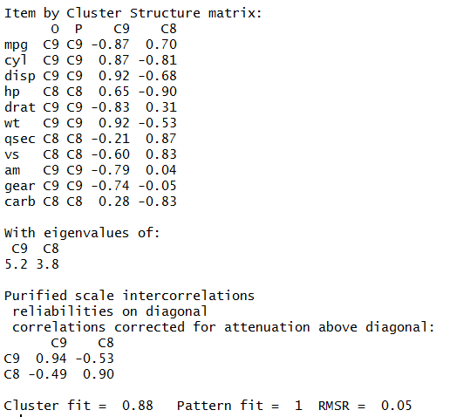
Psych:Cluster Analysis
iclust(mtcars, nclusters=2)
CSCI3907-80/CSCI6444-10 Big Data and Analytics
4-<number>
Notes:
Psych is a general-purpose tool box for personality, psychometric theory and experimental psychology. Functions are primarily for multivariate analysis and scale construction using factor analysis, principal component analysis, cluster analysis and reliability analysis. See psych.pdf when you download the package.
Lots of useful function that can provide different insights into data.
Cluster analysis constructs correlations between variables that reflect that each item loads (contributes) on at most one cluster, and that items
that load on those clusters correlate as a function of their respective loadings on that cluster.
Also, different clusters correlate as a function of their respective cluster loadings and the intercluster correlations.

Slide 35
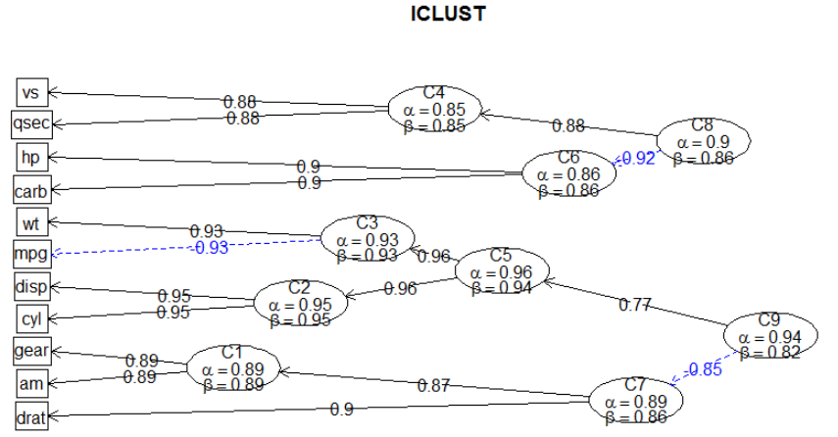
Psych:Cluster Analysis
CSCI3907-80/CSCI6444-10 Big Data and Analytics
4-<number>
Notes:
As with kmeans, you specify the number of clusters that you think might be appropriate.
You have to experiment with the number of clusters.
iclust(r.mat, nclusters=0, alpha=3, beta=1, beta.size=4, alpha.size=3, correct=TRUE,correct.cluster=TRUE, reverse=TRUE, beta.min=.5, output=1, digits=2,labels=NULL,cut=0, n.iterations =0, title="ICLUST", plot=TRUE, weighted=TRUE,cor.gen=TRUE,SMC=TRUE,purify=TRUE,diagonal=FALSE)

Slide 36
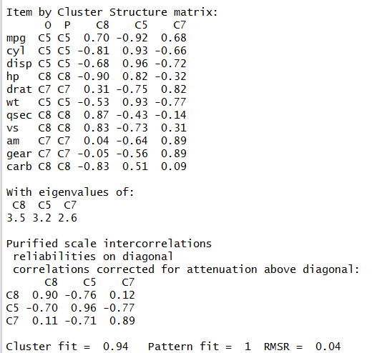
Psych:Cluster Analysis
iclust(mtcars, nclusters=3)
CSCI3907-80/CSCI6444-10 Big Data and Analytics
4-<number>
Notes:
See the plot on the next slide
Note that the number of clusters generated is reduced from 9 to 8.
This indicates that 3 clusters is somewhat better than two.

Slide 37
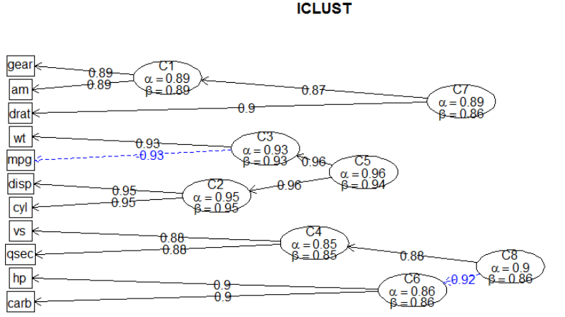
Psych:Cluster Analysis
CSCI3907-80/CSCI6444-10 Big Data and Analytics
4-<number>
Notes:
You see that mpg, wt, disp, and cyl – factors that you normally would expect to directly related – cluster into C5.
You also see that hp = horsepower and carburators are clustering together. The top three factors don’t really contribute much to HP, but do contribute to performance efficiency when you measure that.
This clustering suggests that – for predictive purposes – which we will address next week, we should pick wt, mpg, disp, cyl, and carb with hp as the dependent variable or, alternatively, make mpg the dependent variables if you are interested in fuel efficiency.

Slide 38
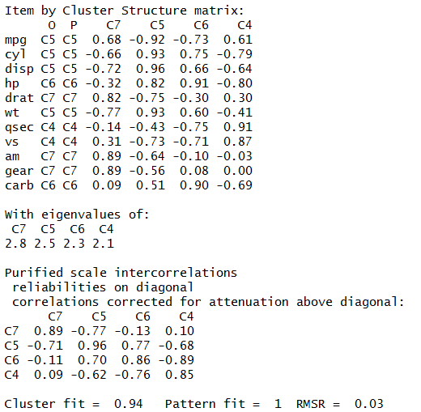
Psych:Cluster Analysis
iclust(mtcars,nfactors=4)
Root Mean Square is the square root of the arithmetic mean of the squares of a set of numbers.
It is a measure of the goodness of fit
of the estimator to the data.
The greater the difference in (x_{k}-u_{k}),
the greater the RMS and spread of the cluster.
CSCI3907-80/CSCI6444-10 Big Data and Analytics
4-<number>
Notes:
And, with four clusters,
We are looking at the Root Mean Square Error as a measure of the goodness of the clustering.
We want that to decrease.

Slide 39
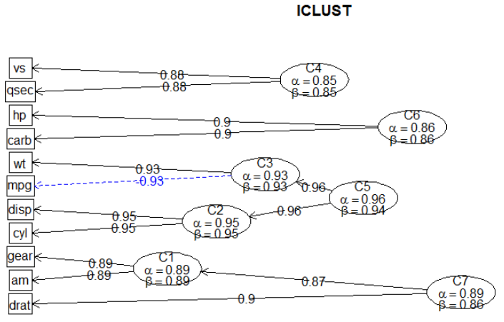
Psych:Cluster Analysis
CSCI3907-80/CSCI6444-10 Big Data and Analytics
4-<number>
Notes:
Notice that the top two factors and the bottom three factors cluster as one would expect.
Then, we can choose between mpg or hp as the dependent variable.
Wt, disp, cyl and carb are all fixed by the model of the car.
So, when examining the factors to consider in item clustering, understanding which are fixed physical factors and which are dynamic is important.

Slide 40
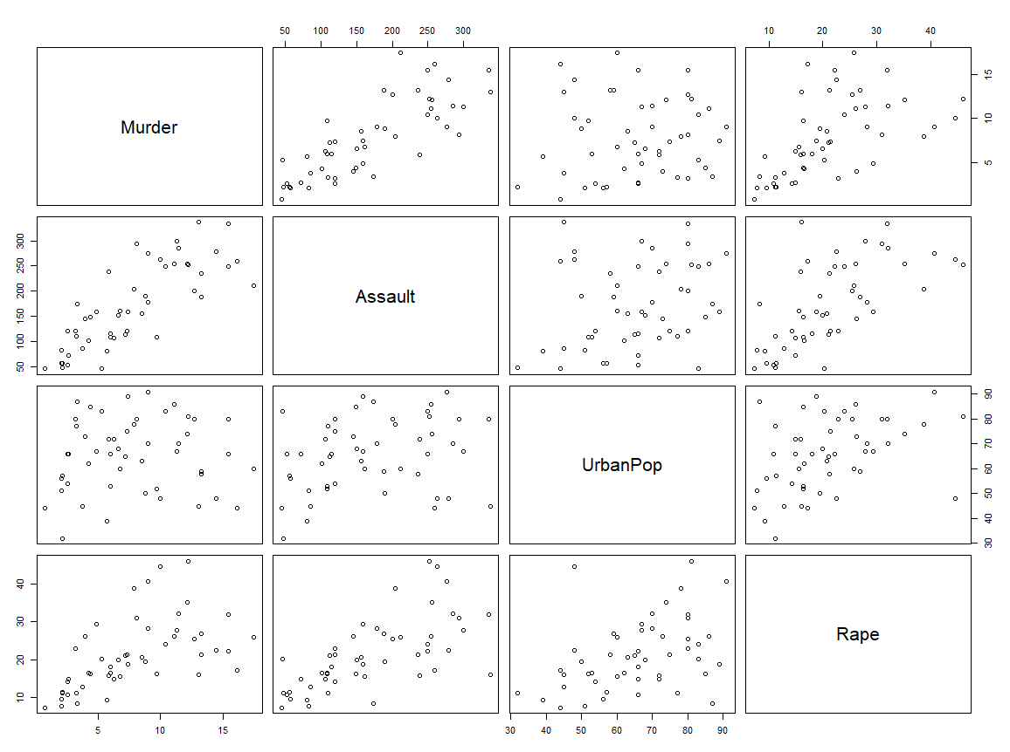
Plotting is Your Friend!!
plot(USArrests)
Oops! No causative effect here?
Note: Looks like a causative relation!
Ummm! Maybe here?
CSCI3907-80/CSCI6444-10 Big Data and Analytics
4-<number>
Notes:
We use plotting to see if we can identify possible causative factors early.
This can help us to decide on an initial number of clusters to look for and also to understand whether there are dependencies between two or more factors.
Generally, we want to assume linearity because it makes modeling easy, but – in practice- it usually not the case.
In such a case we have to ask what type of dependency exists between two factors: positive, negative, neutral

Slide 41
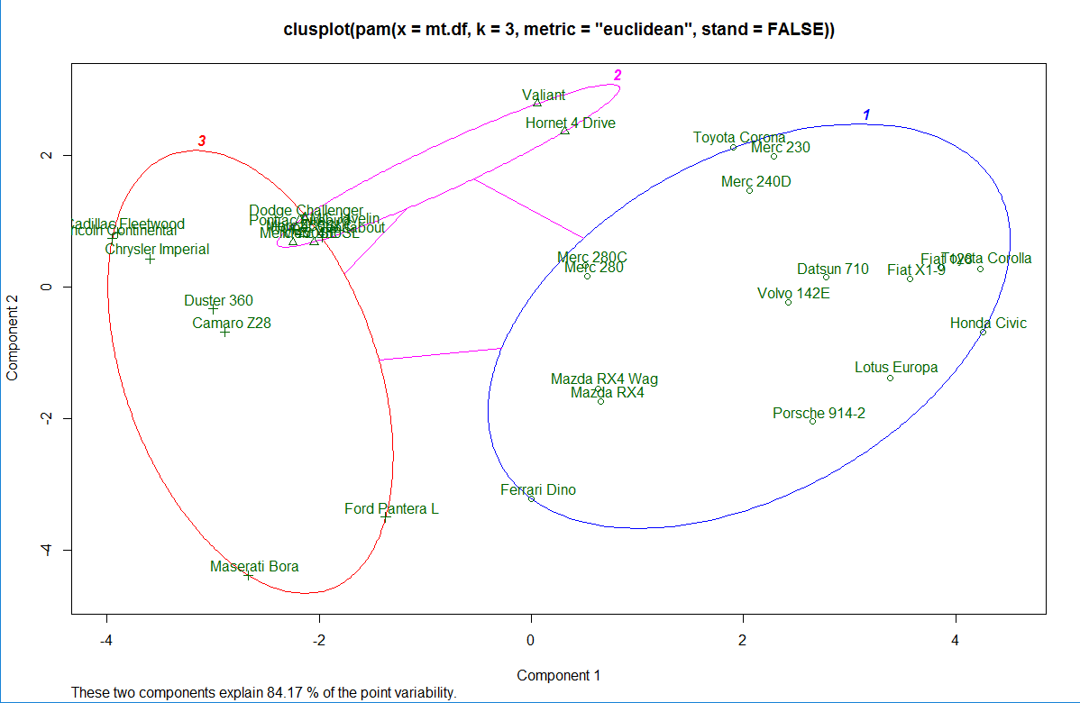
CLUSPLOT(mt.pam,…)
CSCI3907-80/CSCI6444-10 Big Data and Analytics
4-<number>
Notes:
Another type of plotting
Note in the left side, the overlap of two clusters.
Note that cluster 2 – the thin oval – almost merges with cluster one.

Slide 42
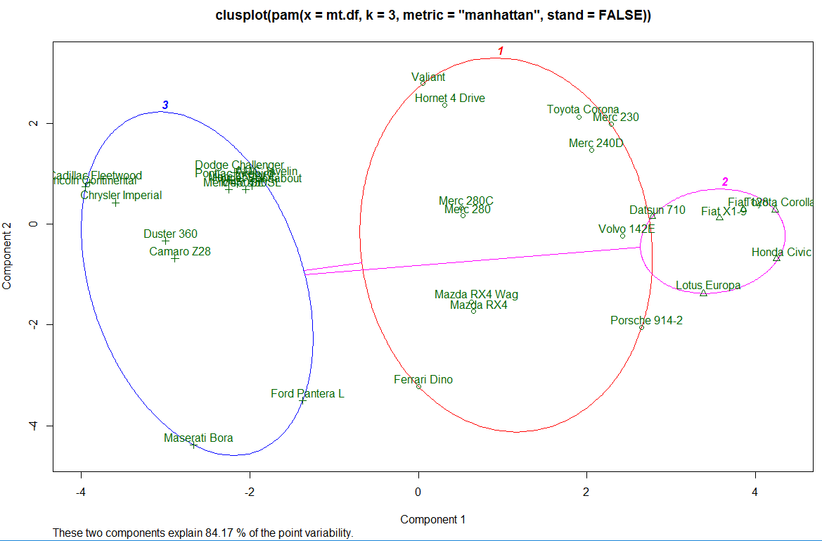
CLUSPLOT(mt.pam2,…)
CSCI3907-80/CSCI6444-10 Big Data and Analytics
4-<number>
Notes:
Now, we see better separation in three clusters.
However, there is significant inter cluster dispersion.

Slide 43
Othering Clustering Techniques
Clustering
Hierarchical
Partitional
Single Link
Complete Link
Square Error
Mixture Maximization
CobWeb
K-means
Expectation Maximization
CSCI3907-80/CSCI6444-10 Big Data and Analytics
4-<number>
Notes:
Hierarchical clustering, as the name suggests is an algorithm that builds hierarchy of clusters. This algorithm starts with all the data points assigned to a cluster of their own. Then two nearest clusters are merged into the same cluster. In the end, this algorithm terminates when there is only a single cluster left.
The results of hierarchical clustering can be shown using dendrogram.

Slide 44
Predictive Analytics
Predictive analytics utilizes a variety of statistical, modeling, data mining, and machine learning techniques to study recent and historical data, thereby allowing analysts to make predictions about the future.
"The purpose of predictive analytics is NOT to tell you what will happen in the future. It cannot do that. In fact, no analytics can do that. Predictive analytics can only forecast what might happen in the future, because all predictive analytics are probabilistic in nature.“
- Michael Wu, Lithium Technologies
Predictive analytics doesn't predict one possible future, but rather "multiple futures“.
CSCI 6444: Big Data & Analytics
3-<number>
Notes:
Prediction is an overused term that suggests the algorithm can tell you the future.
What is actually happening is it is forecasting a range of possible alternatives based on the parameters that you provide to the glm() function in R.
These are regression-based methods:

Slide 45
Predictive Analytics
Association Models
  Based on the underlying relationships and associations in the data
  Ex: If a customer has subscribed to a particular service, it is extremely likely that he/she will order another service.
  Ex: New car dealers upsell enhancements and packages by understanding the customer’s motivation.
  However, some associations may not be obvious and require deeper analysis
  Causality is a key concept here
  Ex: Jeremy Ginsburg et al, “Detecting Influenza Epidemics Using Search Engine Query Data”, Nature 457, 1012–1014 (2009)
CSCI 6444: Big Data & Analytics
3-<number>

Slide 46
Making Decisions Based on models
“A model is a representation of a system that can be used to answer questions about the system”
“All decisions are based on models …and all models are wrong”
  John Stearman
“All models are wrong, but some are useful”
  George Box
Axiom: It is better to be approximately right than to be absolutely wrong to infinite precision!
CSCI 6444: Big Data & Analytics
3-<number>
Notes:
In doing Data Science, we are building models of perceived situations in the real world.
Models are NOT the Real World, but a proxy for it.
We cannot do experiments in the real world (usually), so we use a proxy on which we can experiment.
But, our models have to have a high degree of fidelity in order to yield results that can be used to make decisions.

Slide 47
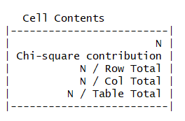
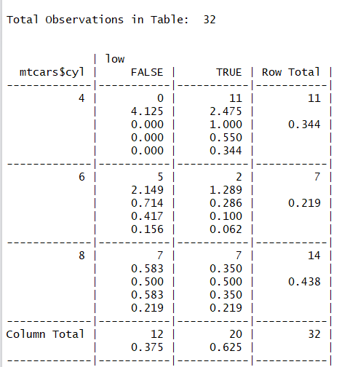
Models
Install.packages(“gmodels”)
….
CrossTable(x = mtcars$cyl, y = low)
Cross-tabulation looks at proportionate distribution of cars by #cylinders relative to # carburetors.
First number in each cell tells # of cars with that combo, e.g., low vs high carburetors.
Proportions tell contribution to chi-square statistic.
So,0.583 (~60%) of high cyl cars do not have low #carbs.
Chi-squared: difference in cell counts is likelihood
Is due to chance alone; low probability implies association.
Read gmodels.pdf
CSCI3907-80/CSCI6444-10 Big Data and Analytics
4-<number>
Notes:
Cross Tables looks at how different attributes correlate based on their contribution.
A contingency table is a way to redraw data and assemble it into a table. And, it shows the layout of the original data in a manner that allows the reader to gain an overall summary of the original data.
Contingency tables provide a way to display the frequencies and relative frequencies of observations, which are classified according to two categorical variables. The elements of one category are displayed across the columns; the
The Chi-square statistic is the primary statistic used for testing the statistical significance of the cross-tabulation table. Chi-square tests determine whether or not the two variables are independent. If the variables are independent (have no relationship), then the results of the statistical test will be “non-significant” and we are not able to reject the null hypothesis, meaning that we believe there is no relationship between the variables. If the variables are related, then the results of the statistical test will be “statistically significant” and we are able to reject the null hypothesis, meaning that we can state that there is some relationship between the variables. elements of the other category are displayed over the rows.

Slide 48

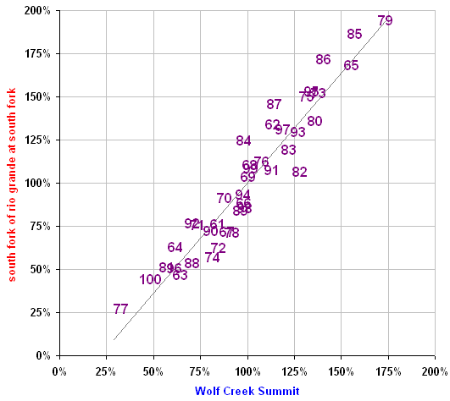


Regression vs. Simulation
Statistical regression
Simulation modeling
S Fork Rio Grande, Colo
Snow
Rainfall
Heat
Apr-Jul streamflow % avg
Snowpack
Soil water
Runoff
May 1 snowpack % avg
Ref: Tom Papagno
CSCI 6444: Big Data & Analytics
3-<number>

Slide 49
Regression
Regression is an analysis process for determining the possible relationships among variables.
  Estimative process
  Often focuses on a dependent variable and its relationship to one or more independent variables.
  Understand how the value of the dependent variable changes with changes in the values of the independent variable(s)
Linear Regression: Explain the relationship between one dependent variable and one or more independent variables
CSCI 6444: Big Data & Analytics
3-<number>
Notes:
Linear Regression uses variables to the first power (hence, the “linear”)
Three major types:
Logistic regression is useful when you are predicting a binary outcome from a set of continuous predictor variables.
Poisson regression is useful when predicting an outcome variable representing counts from a set of continuous predictor variables.
Survival analysis (also called event history analysis or reliability analysis) covers a set of techniques for modeling the time to an event. Data may be right censored - the event may not have occurred by the end of the study or we may have incomplete information on an observation but know that up to a certain time the event had not occurred (e.g. the participant dropped out of study in week 10 but was alive at that time).

Slide 50
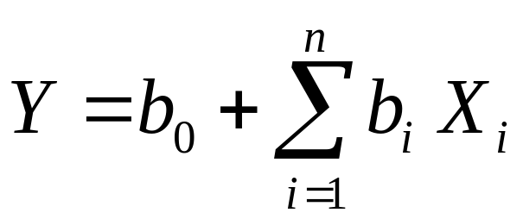
Linear Regression Model
where:
Y = dependent variable
X_{i} = independent variables
b_{i} = regression coefficients
n = number of independent variables
General Assumption:
X’s are independent and normally distributed.
If not, they contain redundant information, and the b’s cannot be easily estimated in any meaningful way
CSCI 6444: Big Data & Analytics
3-<number>
Notes:
From the scatter plot above, it can be seen that not all the data points fall exactly on the fitted regression line. Some of the points are above the blue curve and some are below it; overall, the residual errors (e) have approximately mean zero.

Slide 51
Logistic Regression
Change in probability P is not constant (linear) with constant changes in X.
The probability of a success (Y = 1) given the predictor variable (X) is a non-linear function, specifically a logistic function.
It is not obvious how the regression coefficients for X are related to changes in the dependent variable (Y).
The joint effects of all explanatory variables put together on the odds is
Odds = P/1-P = e ^{α + β1X1 + β2X2 + …+βpXp}
Taking the logarithms of both sides
Log{P/1-P} = log ^{α+β1X1+β2X2+…+βpXp}
Logit P = α+β₁X₁+β₂X₂+..+β_{p}X_{p}
The coefficients β1, β2, βp are such that the sums of the squared distance between the observed and predicted values (i.e. regression line) are smallest.
CSCI 6444: Big Data & Analytics
3-<number>
Notes:
Logistic regression is a method for fitting a regression curve, y = f(x), when y is a categorical variable. The typical use of this model is predicting y given a set of predictors x. The predictors can be continuous, categorical or a mix of both.
The categorical variable y, in general, can assume different values. In the simplest case scenario y is binary meaning that it can assume either the value 1 or 0.
A classical example used in machine learning is email classification: given a set of attributes for each email such as number of words, links and pictures, the algorithm should decide whether the email is spam (1) or not (0).
This model is called “binomial logistic regression”, since the variable to predict is binary, however, logistic regression can also be used to predict a dependent variable which can assume more than 2 values.

Slide 52
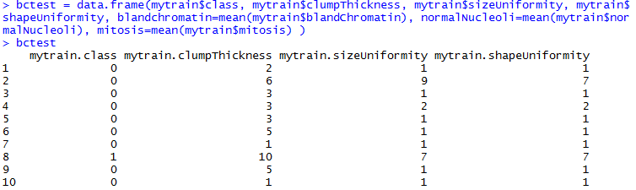
Logistic Regression
Using the breast cancer data
Create a dataframe
  Set the blandChromatin, NormalNucleoli, and mitosis to their means
  Use the variables class, clumpThickness, sizeUniformity, and shapeUniformity.
  Looking at visible attributes of a sample
CSCI 6444: Big Data & Analytics
3-<number>

Slide 53
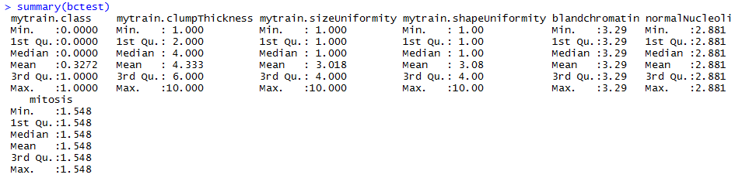
Breast Cancer Data: Summary of Key Variables
Summary(…) describes the distribution of the original data into quartiles.
Note: since blandChromatin, normalNucleoli, and mitosis values were replaced by mean, they have even distribution.
CSCI 6444: Big Data & Analytics
3-<number>

Slide 54
Regression
Logistic regression is useful when you are predicting a binary outcome from a set of continuous predictor variables.
Poisson regression is useful when predicting an outcome variable representing counts from a set of continuous predictor variables.
Survival analysis (also called event history analysis or reliability analysis) covers a set of techniques for modeling the time to an event.
  Data may be right censored - the event may not have occurred by the end of the study or we may have incomplete information on an observation but know that up to a certain time the event had not occurred (e.g., the participant dropped out of study in week 10 but was alive at that time).
CSCI 3907-80/CSCI 6444-10 Big Data & Analytics
3-<number>

Slide 55
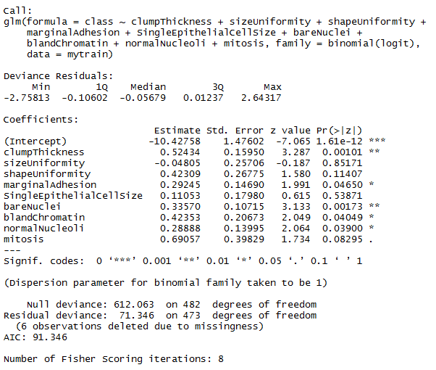
Logistic Regression - I
summary(fit.train)
Note: class must be 0 or 1
as categorical variable
Notice: You define the
dependent variable in
terms of the other variables
Tells us which factors are
Least important
(lowest P value)
Try different equations to
See impacts of factors
CSCI 6444: Big Data & Analytics
3-<number>
Notes:
Use anova(model, test=“Chisq”) to analyze the table of deviance.
A large p-value indicates that the model without the variable explains more or less the same amount of variation.
The library pscl can be used to assess the model fit

Slide 56
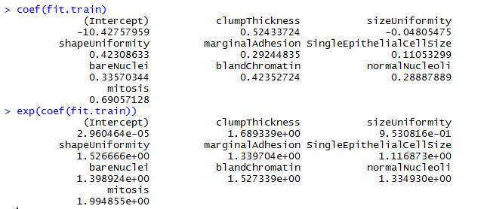
Logistic Regression - II
The coefficients (column 1 = Estimate) show the change in the response for a unit change in the predictor variable (one of the 9 used in the equation).
shapeUniformity estimates correlates well with Probability.
The glm() uses the log(odds) to assess the Probability that Y=1.
So, use an exponentiation to get a better idea:
Since variables 1
to 9 cannot be 0,
the interceptor
doesn’t tell us
anything.
CSCI 6444: Big Data & Analytics
3-<number>

Slide 57
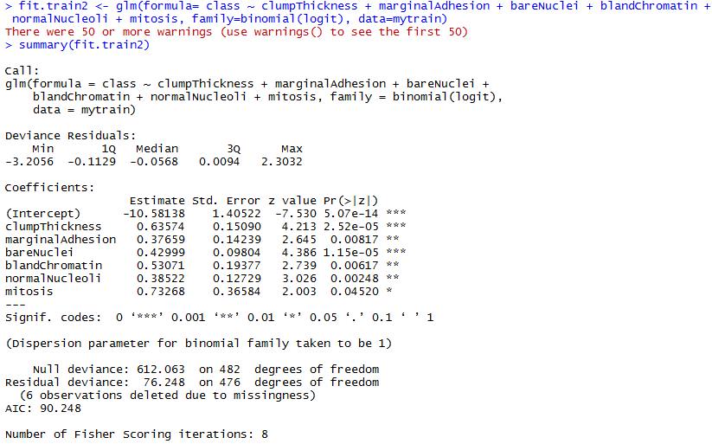
Logistic Regression - III
Without shapeUniformity and singleEpithelialCell…
Now, one can see that all variables contribute to selecting the class.
Each regression coefficient has p <= 0.05.
CSCI 6444: Big Data & Analytics
3-<number>

Slide 58
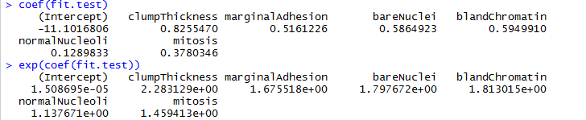
Logistic Regression - IV
Fix the class variable (as before)
  - must be categorical e.g., 0 and 1
In LR, the response being modeled is log(odds) that Y = 1, e.g., unit change in the predictor variable leads to unit change in response
Use exp(…) to put results on an odds scale
Odds of breast cancer are increased by a change in clumpThickness of 2.28
CSCI 6444: Big Data & Analytics
3-<number>

Slide 59
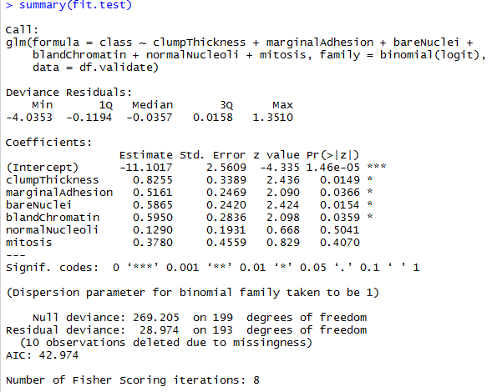
Logistic Regression - V
Compare the two results:
Are they consistent?
So, reduced formula is
as good a predictor as
full formula
Moral: try to go with simplest formula that you can use.
CSCI 6444: Big Data & Analytics
3-<number>

Slide 60
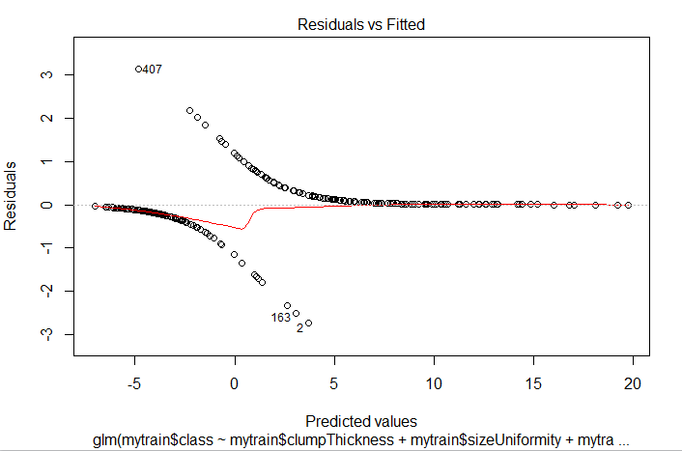
Visual Indicators – Breast Cancer fit
Note the curved relationship which indicates the possible need for a quadratic term in
the regressions
CSCI 6444: Big Data & Analytics
3-<number>
Notes:
Visual indicators often tell you something about the relationship between the variables.
Remember: We are trying to find a good linear model.
Models with higher powers (usually 2 or 3) indicate some dependencies among the variables.

Slide 61
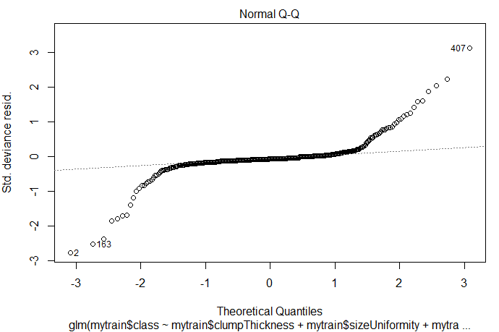
Visual Indicators
If the dependent value is normally distributed, residual values should have a mean of 0 and points should fall on a 45-degree line.
Because they don’t, the normality assumption has been violated
CSCI 6444: Big Data & Analytics
3-<number>
Notes:
This data set has some outliers:
You may eliminate the outliers to see if you get a better fit, but that may be eliminating some critical data
Need good domain knowledge to make these decisions.

Slide 62
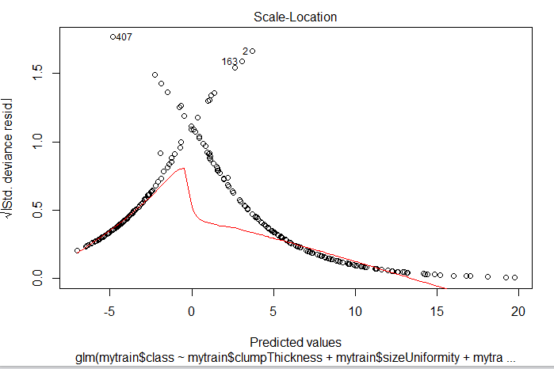
Visual Indicators
If the points have a constant variance, the points should form a random band around a horizontal line.
But, not the case here
CSCI 6444: Big Data & Analytics
3-<number>
Notes:
Again, this indicates that there is some dependency between the variables.
Domain knowledge is required to help you interpret these graphs to decide whether to eliminate variables or change your formula.

Slide 63
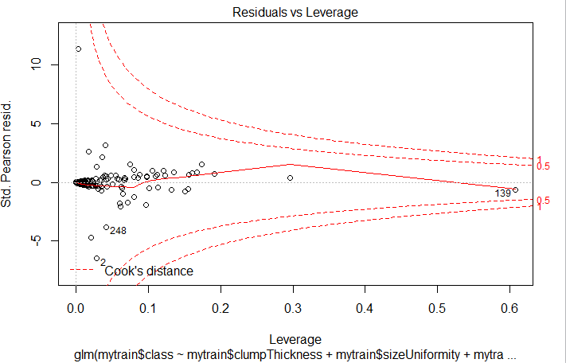
Visual Indicators
The Residuals vs. Leverage graph provides information about individual observations.
It identifies outliers, high-leverage points, and influential observations.
Outliers:
CSCI 6444: Big Data & Analytics
3-<number>

Slide 64
Data Reduction - I
Many data sets have large numbers of instances.
This can make for some complex processing since not all attributes will necessarily contribute to a partitioning of the data set into classes.
So, to make the problem more tractable, you may need to reduce the dimensionality by eliminating some of the attributes.
The problem is how to determine which attributes contribute the least to determining the members of the unsure class.
Why reduce dimensionality?
  Reduce time complexity: less computation
  Reduce space complexity: less parameters
  Don’t have to observe eliminated features
  Simpler models more robust on smaller data sets
  Simple explanations often good enough
  Can plot data in 2- or 3-D visualizations; more understandable
CSCI3907-80/CSCI6444-10 Big Data and Analytics
4-<number>
Notes:
Each factor effectively represents a dimension in a feature space.
As we have see, not all factors contribute significantly to clustering. And, thus, some of the non-contributing factors do not help us understand the clusters.
If we reduce the dimensionality, it may make prediction easier and also make visualization easier.
Reducing the number of features in clustering reduces the number of comparison to be made within each cluster at each iteration.

Slide 65

Data Reduction - II
Summarize a data set with n x p attributes to one with n x k attributes (k < p):
  Assume k attributes are most valuable in representing the data set
Residual information in A not retained in X
Principal Components Analysis: a data reduction technique that reduces the number of variables in a data set for easier explanation
CSCI3907-80/CSCI6444-10 Big Data and Analytics
4-<number>
Notes:
The principal components of a collection of points in a real p-space are a sequence of p direction vectors where the ith vector is the direction of a line that best fits the data while being orthogonal to the first i−1 vectors.
Principal component analysis (PCA) is the process of computing the principal components and using them to perform a change of basis on the data
If yo u have trouble with these terms, look up vector calculus on Wikipedia.
Orthogonality means that all vectors are 90 degrees from all other vectors. We can see this easily in 2D and 3D space, but beyond that it is difficult to visualize.
Einstein was able to do it when formulating General Relativity.
In most cases, three attributes are enough to explain most of the phenomena we see, but then we may add a few more. Remember the 80-20 rule!!

Slide 66
Principal Components Analysis - I
Use principal() in the psych package
  The principal components are linear combinations of the observed variables
  The principal components are orthogonal to each other (think vector spaces)
principal() does an eigenvalue decomposition and returns eigenvalues, loadings, and degree of fit:
  PCx contains the principal component loadings, which are the correlations of the observed variables with the principal components
  Returns a subset of just the best n factors.
  SS contains the eigenvalues associated with the components
  ProportionVar is the amount of variance accounted for by each component.
  Notice: χ² is trending towards 0 as # factors increases.
CSCI3907-80/CSCI6444-10 Big Data and Analytics
4-<number>
Notes:
To interpret each principal component, examine the magnitude and the direction of coefficients of the original variables. The larger the absolute value of the coefficient, the more important the corresponding variable is in calculating the component.
The mathematics behind PCA:
Take the whole dataset consisting of d+1 dimensions and ignore the labels such that our new dataset becomes d dimensional.
Compute the mean for every dimension of the whole dataset.
Compute the covariance matrix of the whole dataset.
Compute eigenvectors and the corresponding eigenvalues.
Sort the eigenvectors by decreasing eigenvalues and choose k eigenvectors with the largest eigenvalues to form a d × k dimensional matrix W.
Use this d × k eigenvector matrix to transform the samples onto the new subspace.

Slide 67

Orthogonality
In geometry, two Euclidean vectors are orthogonal if they are perpendicular, i.e., they form a right angle.
In Euclidean space, two vectors are orthogonal if and only if:
  their dot product is zero, i.e. they make an angle of 90° (π/2 radians), or
  one of the vectors is zero.
  Hence orthogonality of vectors is an extension of the concept of perpendicular vectors to spaces of any dimension..
CSCI3907-80/CSCI6444-10 Big Data and Analytics
4-<number>
Notes:
Note the key word Euclidean.
In Minkowksian or other spaces, orthogonality will have a different meaning.
Given vectors X’ and Y’, we want to change their basis so they are aligned with the X and Y axes.
This does not mean that their relationship changes, only that the values projected onto the X and Y axes change.

Slide 68
Chi-Squared Test
Chi-squared Test (χ²)
  A measure of the discrepancy between the expected results and the observed results, e.g., measure of goodness of fit.
  Designed to analyze categorical data. That means that the data has been counted and divided into categories.
Two potential disadvantages of χ² are:
  The chi square test can only be used for data put into classes (bins).
  If you have non-binned data you’ll need to make a frequency table or histogram before performing the test.
  It requires a sufficient sample size in order for the chi-square approximation to be valid.
If expected and observed values are equal then χ² will be equal to zero.
If χ² is very small, then the expected and observed values are close.
CSCI3907-80/CSCI6444-10 Big Data and Analytics
4-<number>
Notes:
The distribution of a categorical variable in a sample often needs to be compared with the distribution of a categorical variable in another sample.
The Chi-Square Test of Independence determines whether there is an association between categorical variables (i.e., whether the variables are independent or related). It is a nonparametric test.
The Chi-Square Test of Independence can only compare categorical variables. It cannot make comparisons between continuous variables or between categorical and continuous variables.
Additionally, the Chi-Square Test of Independence only assesses associations between categorical variables, and can not provide any inferences about causation.

Slide 69

Principal Components Analysis-I
Eigenvalues
CSCI3907-80/CSCI6444-10 Big Data and Analytics
4-<number>
Notes:
This example uses breast cancer data that is available form the UCI Machine Learning repository.
This is a well-known and validated data set that has been used in many ML programs.
Read up on principal in the psych package documentation. Several parameters you can use to do your analysis.
See this site: https://www.rdocumentation.org/packages/psych/versions/2.0.12

Slide 70

Principal Components Analysis - II
  A measure of the difference between the observed values and the expected values.
CSCI3907-80/CSCI6444-10 Big Data and Analytics
4-<number>
Notes:
Note that chi-square reduces as we go to three factors.

Slide 71
Scree Plot
A line plot of the eigenvalues of factors or principal components in an analysis.
Used to determine the number of principal components to keep in a principal component analysis (PCA).
Always displays the eigenvalues in a downward curve, ordering the eigenvalues from largest to smallest.
The "elbow" of the graph where the eigenvalues seem to level off is found and the components to the left of this point should be retained as significant.
CSCI3907-80/CSCI6444-10 Big Data and Analytics
4-<number>
Notes:
A scree plot is a diagnostic tool to check whether PCA works well on your data or not.
Principal components are created in order of the amount of variation they cover: PC1 captures the most variation, PC2 — the second most, and so on.
Each of them contributes some information of the data, and in a PCA, there are as many principal components as there are characteristics.
Leaving out PCs and we lose information.
The good news is, if the first two or three PCs have capture most of the information, then we can ignore the rest without losing anything important.
A scree plot shows how much variation each PC captures from the data.
The y axis is eigenvalues, which essentially stand for the amount of variation.
Use a scree plot to select the principal components to keep. An ideal curve should be steep, then bends at an “elbow” — this is your cutting-off point — and after that flattens out.

Slide 72


Scree Plot: Getting An Idea of Components
CSCI3907-80/CSCI6444-10 Big Data and Analytics
4-<number>
Notes:
A scree plot is a line plot of the eigenvalues of factors or principal components in an analysis.
The scree plot is used to determine the number of factors to retain in an exploratory factor analysis (FA) or principal components to keep in a principal component analysis (PCA).
Note that the scree plot here has performance a PCA before generating the plot.
If you end up with too many principal components (more than 3), PCA might not be the best way to visualize your data.

Slide 73
PCA Advantages/Disadvantages
PCA handles near collinearities among a set of regression variables in a linear regression.
Most PCA algorithms are “incomplete”:
  Compute first k principal components which explain most of the variance
  Regress the response variable on those k components
  The remaining components that are dropped correspond to near collinearities.
  Thus, standard errors are reduced, but the estimates are biased.
  The more components dropped, the greater the bias.
Thus, need to experiment with number of components to keep.
PCA does not consider the response variable when deciding which components to drop.
  No a priori reason to assume components with biggest variance are the best to drop.
But, it is widely used , easy to use, and gives mostly reasonable results.
CSCI3907-80/CSCI6444-10 Big Data and Analytics
4-<number>
Notes:
Advantages:
Removes Correlated Features: You cannot run your algorithm on all the features as it will reduce the performance of your algorithm and it will not be easy to visualize that many features in any kind of graph. So, you MUST reduce the number of features in your dataset.
Reduces Overfitting: Overfitting mainly occurs when there are too many variables in the dataset. So, PCA helps in overcoming the overfitting issue by reducing the number of features.
Improves Visualization: use 2D Scree Plot to see which Principal Components result in high variance and have more impact as compared to other Principal Components.
Disadvantages:
Independent variables become less interpretable: After implementing PCA on the dataset, your original features will turn into Principal Components. Principal Components are the linear combination of your original features. Principal Components are not as readable and interpretable as original features.
You must standardize your data before PCA
3. Information Loss: if we don't select the number of Principal Components with care, it may miss some information as compared to the original list of features.

Slide 74
PCA: Eigenvectors
With n dimensions, there will be n eigenvectors.
Each eigenvalue has an associated eigenvector.
  An eigenvalue is the length of an axis, the eigenvector determines its orientation in space.
Once the eigenvectors are ordered highest to lowest, smaller eigenvectors in the rightmost columns can be dropped without (usually) significant loss of information.
A feature vector is a vector of the eigenvectors that were computed:
Feature vector = (eig1, eig2, eig3, …., eign)
Finally, the final data set is computed by taking the transpose of the feature vector times the transpose of the data matrix.
Final data set = FV^{T} * ADS^{T}
CSCI3907-80/CSCI6444-10 Big Data and Analytics
4-<number>

Slide 75

Principal Component Analysis
A technique for mapping a multidimensional space to 2 or 3 dimensions
Given vector x, its projection on some axis w is z = W^{T}(x – m)
Maximize var(Z) by choosing eigenvectors as new dimension’s bases
Var(z) = w^{T} E[(x – μ)(x –μ)^{T}]w = w^{T} ∑ w
Var(x)= E[(x – μ)(x –μ)^{T}] = ∑
The eigenvectors (weights) are based solely on the intercorrelations among the X’s and have no knowledge of Y
Center data at origin and rotate axes - improve understanding
CSCI3907-80/CSCI6444-10 Big Data and Analytics
4-<number>
Notes:
I assume that you are familiar with matrix algebra and matrix computations.
If not, try this tutorial:
https://stattrek.com/tutorials/matrix-algebra-tutorial.aspx

Slide 76

PCA-I
Take a d-dimensional data set minus any labels
Assume d=3 for illustrative purposes
Assume that the samples stem from two different classes, where one-half samples of our dataset are labeled class 1 and the other half class 2.
Let our data matrix X be the score of three students:
CSCI3907-80/CSCI6444-10 Big Data and Analytics
4-<number>

Slide 77


PCA-II
Compute the mean of every dimension of the whole dataset.
Represent the data as a matrix:
The mean of the matrix would be:
CSCI3907-80/CSCI6444-10 Big Data and Analytics
4-<number>

Slide 78


PCA-III
Compute the covariance matrix of the whole dataset
See additional material for the formula
Rewrite the matrix as:
And, its covariance matrix is:
CSCI3907-80/CSCI6444-10 Big Data and Analytics
4-<number>
Notes:
Shown in Blue along the diagonal, we see the variance of scores for each test. The art test has the biggest variance (720); and the English test, the smallest (360). So we can say that art test scores have more variability than English test scores.
The covariance is displayed in black in the off-diagonal elements of the matrix A
a) The covariance between math and English is positive (360), and the covariance between math and art is positive (180). This means the scores tend to covary in a positive way. As scores on math go up, scores on art and English also tend to go up; and vice versa.
b) The covariance between English and art, however, is zero. This means there tends to be no predictable relationship between the movement of English and art scores.

Slide 79




PCA-IV
Compute Eigenvectors and corresponding Eigenvalues
See the additional material for discussion of eigenvectors
Calculating det(A-λI): (I is the Identity matrix)
Simplify
Solve the equation:
The eigenvalues are:
CSCI3907-80/CSCI6444-10 Big Data and Analytics
4-<number>

Slide 80



PCA-V
After solving for eigenvectors, the eigenvectors are:
The eigenvectors only define the directions of the new axis, since they have all the same unit length 1.
Which eigenvectors do we want to drop?
The eigenvectors with the lowest eigenvalues bear the least information about the distribution of the data, and those are the ones we want to drop.
After sorting eigenvectors in
decreasing order and the corresponding eigenvectors
Source: https://towardsdatascience.com/the-mathematics-behind-principal-component-analysis-fff2d7f4b643
CSCI3907-80/CSCI6444-10 Big Data and Analytics
4-<number>

Slide 81
Principal Component Analysis: Issues
Assumption is that relationships among components are linear:
  If not, the cloud of points twists and turns in p-dimensional space and the principal axes are not sufficiently descriptive.
How many components should we extract?
  Generally 2 or 3 if you want to be able to visualize
  Based in prior experience and theory
  Selecting # components needed to account for some threshold of variance
  Selecting # of components by inspecting eigenvalues of the k x k correlation matrix.
PCA “chases” variability
  PCA directions will be drawn to predictors with the most variability
  Outliers may have significant influence on the directions and resulting scores.
CSCI3907-80/CSCI6444-10 Big Data and Analytics
4-<number>
Notes:
Although we often assume linearity because it simplifies our analysis, in the real word linearity is often missing.
This is a brief exposure to PCA. There are many good packages that handle PCA and Singular Value Decomposition for multidimensional data sets where, if you understand the basics, you don’t need to fully understand the mathematics.
Since we are looking for explanations of variability, PCA is a good choice to help with dimension reduction to find those components that vary the most.

Slide 82
Observation
“In the end, [predictive modeling] is not a substitute for intuition, but a complement”
Ian Ayres, in Supercrunchers
CSCI3907-80/CSCI6444-10 Big Data and Analytics
4-<number>

Slide 83
Further Reading
Pelleg, D. and Andrew Moore. 1999. “Accelerating Exact k-means Algorithms with Geometric Reasoning”, Proc. Conference on Knowledge Discovery in Databases 1999.
See the following:
  pcaTutorial.pdf
  An Introduction to Clustering and different methods of clustering.docx
Hartigan, JA, and MA Wong. 1979. “Algorithm AS 136: A K-means clustering algorithm.” Applied Statistics. Royal Statistical Society, 100–108.
MacQueen, J. 1967. “Some Methods for Classification and Analysis of Multivariate Observations.” In Proceedings of the Fifth Berkeley Symposium on Mathematical Statistics and Probability, Volume 1: Statistics, 281–97. Berkeley, Calif.: University of California Press. http://projecteuclid.org:443/euclid.bsmsp/1200512992.
CSCI3907-80/CSCI6444-10 Big Data and Analytics
4-<number>

Slide 84
Additional Material
CSCI3907-80/CSCI6444-10 Big Data and Analytics
4-<number>

Slide 85
Ten Popular Clustering Algorithms
Affinity Propagation
Agglomerative Clustering
BIRCH
DBSCAN (Density-Based Spatial Clustering of Applications with Noise
K-Means
Mini-Batch K-Means
Mean Shift
OPTICS
Spectral Clustering
Mixture of Gaussians (Expectation Maximization)
Look these up on Wikipedia!
CSCI3907-80/CSCI6444-10 Big Data and Analytics
4-<number>

Slide 86
Cluster Analysis - I
Choose appropriate attributes;
  Look for attributes that differentiate items in the set
  A sophisticated cluster analysis cannot compensate for a poor choice of variables
Scale the data
  If the variables vary in range, the variables with the largest values will predominate and skew results
  Normalize (standardize) variables to a range [0…1] with standard deviation of 1.
  Other techniques may apply
Screen for outliers:
  Many clustering techniques are sensitive to outliers
  Use the outliers package to assist you (or, mvouttlier for multivariate
  outliers
  Use clustering technique robust in presence of outliers
CSCI3907-80/CSCI6444-10 Big Data and Analytics
4-<number>

Slide 87
Cluster Analysis – II
Calculate distances:
  Select a distance measure: Euclidean, Manhattan, Minkowski, and so on.
Select a clustering algorithm:
  Hierarchical clustering is good for a few hundred observations
  Partitioning methods handle much larger data sets
Apply the clustering algorithm varying the parameters:
Determine # clusters present:
  Tough problem, no generic solutions
  Domain knowledge helpful
  Use the NbClust package which has 30 indices
Obtain a final clustering solution:
  Perform a final clustering with the best set of parameters
  There is NO optimal solution, usually
CSCI3907-80/CSCI6444-10 Big Data and Analytics
4-<number>

Slide 88
Cluster Analysis – III
Visualize the results:
  Hierarchical clustering usually displayed as a dendrogram
  Partitioning clustering usually displayed as bivariate cluster plot
  You may have to select pairs of variables to plot (latter case)
Interpret the clusters:
  Examining the clusters, find what is common and what is not
  Requires domain knowledge
  Obtain summary statistics
  If categorical variables, look at modes and/or category distributions
Validate the results:
  Are these groupings represented in the real world in some way?
  If a different clustering method was used, would the same clusters be obtained?
  Try the fpc, clv, and clValid packages
CSCI3907-80/CSCI6444-10 Big Data and Analytics
4-<number>

Slide 89
Canonical Correlation
Used to investigate the how much variance in one set of variables is accounted for by the other set along one or more axes.
  If there is more than one axis, they must be orthogonal.
Homoscedasticity implies that the relationship between two variables is constant over the full range of data and this increases the accuracy of canonical correlation.
Linearity is an important assumption of canonical correlation; this technique finds linear relationships between variables within a set.
Outliers have a disproportionate impact on the results of the analysis.
Because canonical correlation is very sensitive to small changes in the data set, the decision to eliminate cases or estimate missing data must be considered carefully.
CSCI3907-80/CSCI6444-10 Big Data and Analytics
4-<number>

Slide 90
Variance & Covariance
Variance measures the spread of data in a data set
  For 1-D data, computation is straightforward
Consider 2-D data: how do each of the dimensions vary with each other
  Data points with two attributes; think of them as x and y, which you can plot on a 2-D graph
  Lots of points makes it difficult to visualize patterns in the data
  Example: # hours studied versus grades obtained
  Yields a number, but what does it mean?
    = 0, the two dimensions are independent of each other
    > 0, two dimensions vary together
    < 0, two dimensions vary in opposition
  With 2-D can usually visualize this result, but 3-D and beyond cannot visualize so need some way to characterize how the different dimension relate to each
Cov(x,y) = Σ (x_{i} –x) (y_{i} – y)/(n-1) for i =1, n
CSCI3907-80/CSCI6444-10 Big Data and Analytics
4-<number>

Slide 91


Eigenvalues & Eigenvectors
An eigenvalue problem may be written as a matrix equation:
A . v = λ . v
Any solution for λ is the eigenvalue and v is the eigenvector.
CSCI 6444: Big Data and Analytics

Slide 92
Calculating Eigenvalues - I
Suppose we are given: A . v = λ . v
A . v - λ . I . v = 0
(A - λ . I ). v = 0
Finding the roots of |A - λ . I| will give the eigenvalues
Let A = (0 1)
(-2 -3)
Then, (A-λ.I) = (0 1) (λ 0)
(-2 -3) - (0 λ) = 0, then (-λ 1) = λ² + 3λ + 2 = 0
(-2 -3-λ)
So, there are two eigenvalues: λ₁ = -1 and λ₂ = -2
For λ1, the eigenvector is (1 1) (v_{1:1})
(-2 -2) (v_{1:2}) = 0 or v_{1:1} = - v_{1:2}
So, any column vector with components of equal magnitude and opposite sign.
CSCI 6444: Big Data and Analytics
4-<number>

Slide 93
Calculating Eigenvalues - II
Therefore eigenvector v₁ is v₁ = k₁ ( +1)
( -1) where k₁ is some constant
And, eigenvector v₂ is v₂ = k₂ (+1)
(-2) where k₂ is some constant
And the eigenvalues are λ₁ = -1 and λ₂ = -2
Eigenvectors can only be found for square matrices; not every square matrix has eigenvectors.
Given an n x n matrix, we can find n eigenvectors
CSCI 6444: Big Data and Analytics
4-<number>

